Slide 1
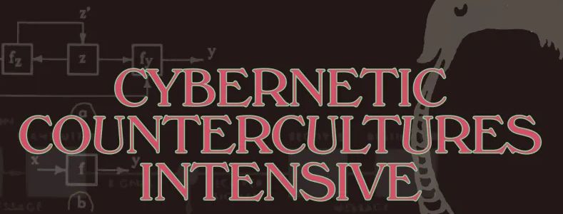
Week 1. Introduction:
The Whole Earth Network, Organic Cybernetics, and the Problem with Intelligence

Slide 2

The Problem with Intelligence
Part Two

Slide 3
Bruce Clarke
The Problem with Intelligence
“There is no good definition for intelligence.”
Or at least, so say Rolf Pfeifer, Director of the Artificial Intelligence Laboratory in the Department of Informatics at the University of Zurich, and University of Vermont computer scientist Josh Bongard, in their 2006 book How the Body Shapes the Way We Think.
Nonetheless, the fuzzy semantics of intelligence accords well with the public face of the current generation of AI technologies. Despite a large population of different AI systems, cordoned off into private, generally paywalled corrals by their corporate and entrepreneurial developers, schooled on vastly different training sets, and groomed for highly specified and specialized interactions with human users, as far as the media and popular conversation go, it’s can seem as though it is all the same monolithic edifice—“AI.” AI monotheism: God is One and AI is God. Located in a celestial cloud orbited by communications satellites, AI dwells on high, served by a realm of daemonic messengers between Heaven and Earth including Siri, Watson, Pilot, Gemini, and Chat.

Slide 4
But whatever intelligence is, I’ll wager that it comes distributed in a virtually infinite number of discrete little packets, and the problem is usually how to get the packets to fall into place in relation to our own moment, our own era, in the determination of what our purposes should be, and in their fulfillment. And we can make a serious start here I think by bringing our thoughts about intelligence back home, to organisms. In this context the concept is still deeply problematic—as in, for one, how far should it be extended (and what does that mean?): are cats intelligent? flies? what about trees or mycelial networks, or microbes? But nevertheless, as an opening move, we could acknowledge that there are various forms of natural intelligence, as that emerges from organic bodies of various sorts. And we humans partake of that capacity in our own, occasionally spectacular ways.

Slide 5
A 2022 essay co-authored by Andrea Roli, Johannes Jaeger, and Stuart A. Kauffman, “How Organisms Come to Know the World: Fundamental Limits on Artificial General Intelligence,” suggests an effective way forward, along with a workable definition for grades of intelligence. These authors speak of general intelligence as a mobile set of reasoning skills, here delimited to specific animal capacities:
General intelligence involves situational reasoning, taking perspectives, choosing goals, and an ability to deal with ambiguous information. . . . True general intelligence can be defined as the ability of combining analytic, creative, and practical intelligence. It is acknowledged to be a distinguishing property of “natural intelligence,” for example, the kind of intelligence that governs some of the behavior of humans as well as other mammalian and bird species.

Slide 6
This definition captures the open-endedness of organic intelligence, its ability to recollect, anticipate, and improvise, to have ways to get out of whatever box it’s currently in as the situation demands, or die trying. Roli, Jaeger, and Kauffman see the fabrication of this sort of general intelligence as “the foundational dream of AI—featured in a large variety of fantastic works in science-fiction . . . to create a system, maybe a robot, that incorporates a wide range of adaptive abilities and skills.” The fulfillment of this design goal would be the perfection of AGI, Artificial General Intelligence. While still abstract, this form of the AI concept is also relatively concrete in that the generality at hand is understood as a specific synthesis of mindful qualities by which living beings negotiate their worlds from moment to moment. Most crucially, they continue,
a truly general AI would have to be able to identify and refine its goals autonomously, without human intervention. In a quite literal sense, it would have to know what it wants, which presupposes that it must be capable of wanting something in the first place.

Slide 7
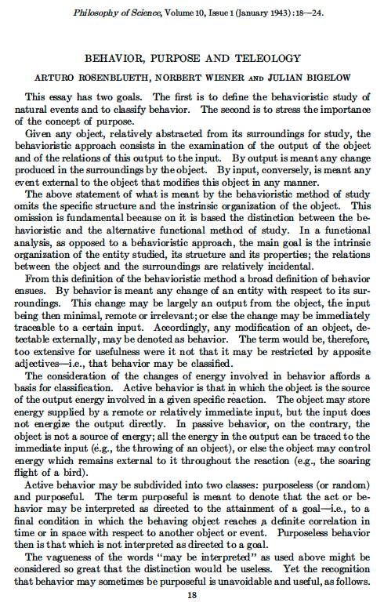
What this formulation implies is that there is something crucial that lies prior to or sets the stage for the emergence of intelligence as some form of effectively skilled behavior—the capacity to conceive purposes at all, the pressure of needs, the abilities to desire and to contemplate. We will return to this issue next week as we explore the earliest roots of cybernetic ideas about purposes and goals.
Arturo Rosenbleuth, Norbert Wiener, and Julian Bigelow, “Behavior, Purpose, and Teleology,” Philosophy of Science 10:1 (January 1943): 18-24.

Slide 8
For now, we can say that, in its origin at least, the notion of machine intelligence is a provocative projection from such general, natural or organic intelligence—as well as, in its implementation, a considerable constriction. Splitting off from the first generation of cybernetic research, a Dartmouth workshop held in 1956 attended by Marvin Minsky, Herbert Simon, and others coined the phrase and produced an initial research agenda for the design and exploration of artificial intelligence. Establishment AI tended to discount the cybernetic origins of its primary theme. Cybernetics had already seized physiological systems in general or discrete organ systems—in particular, the sensory-perceptual side of the nervous system and its prime cellular component, the neuron—to model computational agents befitting the traditional notion of intelligence. And even if AI technologies are only recently making good on many of the field’s initial promises, nonetheless, for fifty years it has been the idea of AI that has enjoyed spectacular institutional success, technological sophistication, value-creation, and incalculable cultural impact.

Slide 9
In all this time it is not the accomplishments of AI as a technoscientific research and development arena that have mattered so much as the promise the AI research program gave to its funding agencies and their publics, the notion and vision of intelligent machines as autonomous agents. In the narrative and visual imaginary of high-tech societies at least since the mid-twentieth century, the glamor of these images remains irresistible. The early success of AI as an intelligible and fundable idea well in advance of its recent breakthroughs had to do at least in part with the circumstance that its goals are so easily tellable. It’s almost too easy a story to tell. In the AI imaginary, machines step right up into roles previously reserved for human beings and then, in some realm of narrative possibility, act “intelligently,” if not always, for the sake of a good story, dispassionately.

Slide 10
And speaking of good stories about intelligence, another narrative line first took shape in 1961, when Frank Drake, Philip Morrison, John Lilly, and Carl Sagan met at the National Radio Astronomy Observatory in Green Bank, West Virginia, to organize the search for extraterrestrial intelligence, known thereafter as SETI. AI and SETI have a common denominator in their mutual entanglement of the problems of intelligence with the mediations of technology. I think this identification of mind with technics is one of modernity’s most stubborn bad habits. The AI mindset exhibits this condition of identification explicitly, in that artificial designates engineered intelligence instantiated in machines, while SETI exhibits this condition implicitly, in the assumption that both we, the Earthling searchers, and the alien beings we seek mutually possess the technological intelligence to construct sufficiently powerful radio telescopes enabling the reception of interstellar signals, and ideally, circuits of communication with alien interlocutors.

Slide 11
Screen shot from the movie Contact
Especially in the context of the SETI project, the word intelligence still carries along vacant theological echoes. The Old English Dictionary notes one definition of intelligence as “an intelligent or rational being; esp. applied to one that is or may be incorporeal; a spirit.” The OED’s examples of this more rarefied usage are especially notable in an astrobiological frame: “1685 Boyle . . . The School Philosophers teach, the Coelestial Orbs to be moved or guided by Intelligences, or Angels. 1756 Nugent . . . The intelligences superior to man have their laws.” The secular projection of this celestial or angelic understanding of “intelligences superior to man” both in their cosmic power and in their enjoyment of incorporeality, of planetary spirits rising superior to the limitations of embodiment, emerges in the merger of the SETI and AI imaginaries to envision superior intelligence in the form of post-biotic civilizations of immortal machines.

Slide 12

For example, I. S. Shklovskii and Carl Sagan’s 1966 volume Intelligent Life in the Universe concludes with this daring if dubious transhumanist speculation: “Cybernetics, molecular biology, and neurophysiology together will someday very likely be able to create artificial intelligent beings which hardly differ from men, except for being significantly more advanced. Such beings would be capable of self-improvement, and probably would be much longer lived than conventional human beings” (486).

Slide 13

[13] Advanced technology per se is taken to be a sign and outcome of the sublimity of human intelligence, even while it is imagined that we are either unwittingly or enthusiastically endowing our machines with a level of sentience that will soon surpass our own. When that happens, one version of the story goes, the intelligent machines will effervesce into some virtual Valhalla, especially once the superior intelligences from across the galaxy start to make cosmic contact among themselves. The irony of the story told by the fusion of AI and SETI is that seeking contact with intelligent alien machines may be a fool’s errand. They will either contact us, on their terms, which we won’t like, or more likely, they will ignore us (the great silence?) preferring each other’s virtual company.

Slide 14
Behind both the AI and SETI imaginaries is the triumphal projection of physics as a secular knowledge of final things. AI narratives typically reproduce Western habits of mind tending to mediate notions of intelligence through the abiotic conceptuality of physics and its applications to the instrumentality of technology. Explicitly adding the notion of AI this mix encourages the idea that, in the fullness of its higher evolution, intelligence may be decoupled from the phenomenon of life. Once intelligence climbs up out of the gravity hole of its organic nursery, it will abandon the embodiment of its planetary scaffolding. When the disembodied spirit of physics alone drives the AI imaginary, its quest for universal mastery finds its fulfillment along SETI lines. Projecting its gaze and methods beyond Earthbound conditions, it discounts or dispenses with the living body. It sets the idea of intelligence apart from, over and above, the organized matter of life.

Slide 15
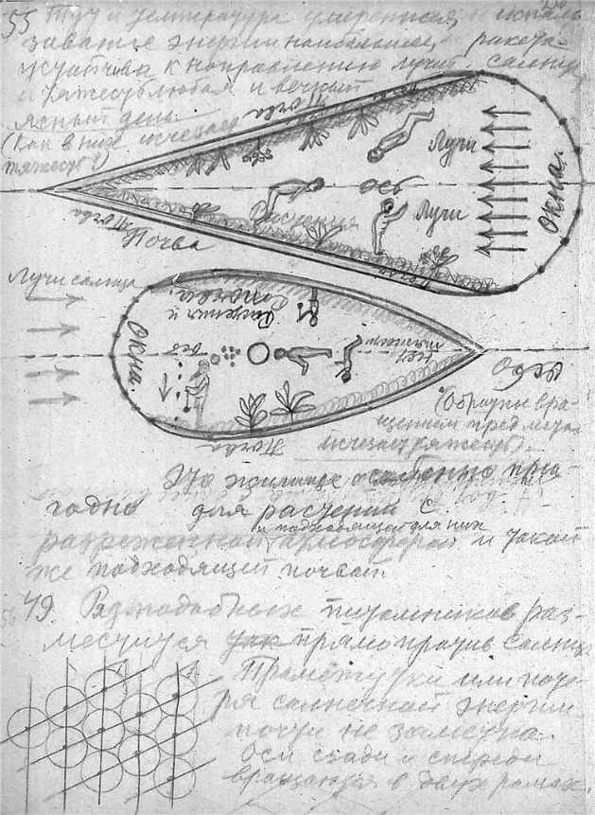

This high mode of scientific heroism throws into relief Pfeifer and Bongard’s arguments in How the Body Shapes the Way We Think concerning the indispensability, for anything deserving the name of intelligence, of some mode of embodiment providing a necessary level of sensory and behavioral interaction with a distinct environment. As these visionary sketches of space habitats make abundantly clear, we will have to take Gaia with us whenever we lift off from the planet. However, the seemingly obvious contingency of intelligence upon organic, biological embodiment splits apart once more within a physical world-picture in which abstract intelligence presumes to master living embodiment. Modern physics’ positing of universal physical constants, such as the speed of light, or the relation of mass to gravity, encourages mathematical reason to project those constants as attributes of universal mind.
Konstantin Tsiolkovsky, Sketches for a Green House in a Space Capsule, 1932
Gerard K. O’Neill’s toroidal space colony in cutaway view, @ 1976

Slide 16
Such a unified physics-based worldview runs alongside the first generations of AI researchers, operating according to “the classical, symbol-processing paradigm,” known in AI discourse as the cognitive paradigm, in which “what matters for intelligence . . . is the abstract algorithm or the program, whereas the underlying hardware on which this program runs is irrelevant.” In short, in the cognitive paradigm of classical AI, the performance of artificial intelligence is carried out by a general operational device or Turing machine assumed to proceed in detachment from or transcendence of whatever material peculiarities may pertain to its technological vehicle. That way, in short, lies the monotony of the Singularity—and quite likely, were that to come to pass, that way lies the demise of the organic viability of the terrestrial biosphere. I would rather value the idea of intelligence in a way that keeps it tethered to its material and organic affordances, and so within reach of human agency to entrain the future technosphere toward a further evolved but ecologically flourishing planet.

Slide 17
Pfeifer and Bongard reported in 2006 that the “cognitivistic paradigm” of good old-fashioned AI “is still very popular among scientists.” Perhaps that has changed somewhat by now, but this residual bias toward embodiment’s dispensability, or at least, its open-ended material substitutability, it seems to me, still captures the contemporary popular understanding or general stereotype of AI. Here a monolithic AI tends to blackbox the incessant feedback loops or non-trivial recursive functions necessary to produce the circularity of cognitive or communicative processes. It puts all that in its “cognitive blindspot,” as von Foerster would say. In the cognitivistic paradigm, moreover, the purported intelligence of computational devices rests upon near-instantaneous serial calculations upon tiers of strictly-coded representations. Fluctuating, unpredictable, or self-referential internal states—that is, the full duress of actual psychic systems placed in social situations—are as yet beyond pre-curated semantic or mathematical signs internally modeling combinations of external objects and events.

Slide 18
Roli, Jaeger, and Kauffman concur that since “an AI agent is an input–output processing device,” there is, as advertised, a “fundamental limit” on how much such a machine can perform, and that limit stops well short of the mode of agency of which living systems are capable:
Although not always explicitly stated, it is generally assumed that input-output processing is performed by some sort of algorithm that can be implemented on a universal Turing machine. The problem is that such algorithmic systems have no freedom from immediacy, since all their outputs are determined entirely—even though often in intricate and probabilistic ways—by the inputs of the system. There are no actions that emanate from the historicity of internal organization. There is, therefore, no agency at all in an AI “agent.”

Slide 19
⊕
At this point, let us take a sharp turn toward the impact of Margulis and Lovelock and ask how the cybernetic history of Gaia theory might help to reframe these interrogations of intelligence. In their 2022 essay published in the International Journal of Astrobiology, “Intelligence as a Planetary Scale Process,” planetary scientist David Grinspoon joins with astrobiologist Sara Walker and astrophysicist Adam Frank to contemplate, within the common nexus of the Gaia theory of Lovelock and Margulis, the emergence of effective planetary management as an index of a kind of collective intelligence operating at a global scale. Information theories developed in the quest for alien technosignatures mingle with some of the systems discourses we are going to approach in this Intensive—especially the cognitive biology of autonomy in complex adaptive and autopoietic systems. I spy between the lines of “Intelligence as a Planetary Scale Process” the image of an embodied technosphere here on Earth—that is, a technosphere operationally coupled by its noosphere to its geosphere and biosphere in a manner that persists through compliance with the recycling regimes already vetted by two billion years of Gaian engineering. Grinspoon, Walker, and Frank pursue a Gaian-systems approach to the mentalistic implications and value presumptions bound up with the concept of intelligence. However, for me the properly Gaian formulation, preferable to planetary intelligence, is planetary cognition. This theoretical framing more securely embeds the technosphere within its biospheric conditions of possibility. I will look into this just a bit as we finish up this evening.

Slide 20
“Intelligence as a Planetary Scale Process” exchanges the prior modern vision of human consciousness triumphant in the cosmos, pursuing the “urge to expand and control,” for a vision of planetary holarchy. To guide the Earth system and its technosphere toward a mature or long-lived formation—the signature activity to be submitted to planetary intelligence—invidious individual or tribal preferences will somehow be transcended. Earlier SETI discourse has now been effectively tempered to a significant degree by a Gaian sensibility. The dream of universal control and of the infinite extraction of cosmological resources is over. The pressing ecological consequences of our own immature technosphere are now evident to more and more Earthlings. It is thus imperative here and now to foster a robust quest for systemic resources to nudge Earth’s technosphere toward durable processes of structural coupling and self-maintenance. In this effort, they write,
The concepts of Biosphere, Noosphere and Gaia – as developed by Vernadsky, Lovelock and Margulis – are the foundations for what follow in our argument. Taken as a whole, they represented the crucial first coherent attempts to recognize that life and its activity (including intelligence) may best be understood in their full planetary context. (50)

Slide 21
Moreover, they note, in the 1980s, Margulis’s particular Gaian sensibility was also cultured in autopoietic systems theory: “autopoiesis figured strongly in Margulis’ exposition of the structure and function of Gaia. As she wrote ‘Living systems, from their smallest limits as bacterial cells to their largest extent as Gaia, are autopoietic: they self-maintain’” (53). However, as Grinspoon, Walker, and Frank turn the idea of planetary intelligence toward the autopoietic line of thought, they set off a semantic eddy in which alternative formulations for the concept of intelligence swirl around the term cognition. Intelligence and cognition are presented as synonyms, but this usage overrides crucial distinctions. I will take a moment to draw these out.

Slide 22
So first, the bias of intelligence is toward faculties of understanding, forethought, and choice, all good things, ranging from lesser to greater powers of application. In the Oxford English Dictionary, the first of seven distinct senses of the term is: “The faculty of understanding; intellect”; the second definition is: “Understanding as a quality admitting of degree; spec. superior understanding; quickness of mental apprehension, sagacity.” In contrast, the basic sense of cognition is the sheer capacity to apprehend or experience an environment. Reviewing the OED’s definitions of cognition, a main line of distinction between the two terms concerns the disposition of knowing. Cognition is defined first as “the action or faculty of knowing; knowledge, consciousness; acquaintance with the subject.” Its second definition homes in on the sensory-perceptual core of the concept: “the action or faculty of knowing taken in its widest sense, including sensation, perception, conception, etc. as distinguished from feeling and volition; Also, more specifically, the action of cognizing an object in perception proper.”
.

Slide 23
To break this down to essentials: whereas consciousness is peripheral to the wider sense of cognition, especially in autopoietic and enactive discourse, it tends to cling to the standard sense of intelligence.
Cognition is knowing, intelligence is understanding.
Cognition is apprehension, intelligence is comprehension.
Moreover, from the start, the discourse of autopoiesis in Maturana and Varela associated that concept with cognition. In this milieu, cognition is given by the qualitative sensory and affective faculties of environmental registration made possible by the all-or-nothing constitutive operations of autopoietic self-production. Ezequiel A. Di Paolo offers a theoretically refined overview of cognition within this milieu of discussion:
For the enactive view, cognition is an ongoing and situated activity shaped by life processes, self-organization dynamics, and the experience of the animate body. This approach is based on the mutually supporting concepts of autonomy, sense-making, embodiment, emergence, and experience.

Slide 24
In my own writing, I have worked with a concept of planetary cognition in order to draw out the implications of Lynn Margulis’s occasional evocations on the topic of autopoietic Gaia. My main point here is simply that, in the discourse of autopoiesis toward which our astrobiologists gesture vigorously throughout their essay, the concept of intelligence is more or less beside the point. It is cognition above all that enables autopoiesis to continue! So I find it intriguing that this essay on planetary intelligence swaps in the term cognition with some consistency, as if in tacit recognition that the latter term has resources of meaning and application not immediately available in the former. This semantic dynamic is especially at play when attention is directed to the Gaia concept as a crucial underpinning for their larger arguments.

Slide 25
In a Gaian context, the sense of cognition hews to the nonhuman biosphere, while the sense of intelligence attaches more tightly to the human realm and its own technosphere. For instance, “by defining planetary intelligence in terms of cognitive activity – i.e. in terms of knowledge that is only apparent at a global scale – we are explicitly broadening our view of technological intelligence beyond species that can reason or build tools in the traditional sense” (48). In other words, as I read this, they affirm a fundamental coupling between the human technosphere and the natural technicity of the nonhuman biosphere. In this assertion their argument indeed drives toward Margulis’s own convictions that the technosphere is not solipsistic and cannot be hermetic but is inextricably coupled to the biosphere as well as the geosphere. They continue: “We will examine whether it is possible to consider intelligence, or some form of cognition, operating on a planetary scale even on those worlds without a planetary-scale technological species” (48). Operating, that is, on worlds such as ours long before we human beings made our appearance. Intelligence emerges on a planet like Earth thanks to a fully mature and long-lived biosphere immunized over geological time by autopoietic Gaia, a massively dynamic foundation for the current human expansion.

Slide 26
Planetary cognition on the Gaian model appears to be the precursor formation, a kind of test-of-concept, for a nonhuman planetary intelligence. They speculate that this approach “would require some form of collective cognition to have been a functional part of the biosphere for considerably longer than the relatively short tenure of human intelligence on Earth. If true, then the inherently global nature of the complex, networked feedbacks which occur in the biosphere may itself imply the operation of an ancestral planetary intelligence” (48). The “collective cognition” in question here implies some sort of multi- or pan-species aggregation, that is, it places a Gaian conception of cognition at the base of these planetary considerations. I think this is the more intelligent way to ground our future plans. What we must try to do is grasp ever more firmly how to integrate our built environment with Gaia’s inexorable contingencies.

Slide 27
And finally, a grasp of planetary cognition on the Gaian model can also scale up our thinking about the continuous communication of necessary messages within our own semiosphere. It is my hope that Cybernetic Countercultures Intensive carries out a piece of this mission to envision the production of Gaian beings and the formation and maintenance of a planetary society globally distributed in lifeform and locality but sharing a common Earth. A return to the knowing and the understanding of Indigenous being for every living being. As Bruno Latour put it in Down to Earth: Politics in the New Climate Regime, “It is not a matter of learning how to repair cognitive deficiencies, but rather of how to live in the same world.” This is the existential and epistemological problem we face: how to construct or entrain, for myriad minds whose portion of intelligence operates in private or in local ensembles that may otherwise never connect, an endangered world held sufficiently in common to enjoin and expand the fruits of shared purposes toward the task of rendering our human presence on this planet fit for the longevity we desire for our posterity.

